Slide 1
Law of Variable Proportions

Slide 2
Law of Variable Proportions
The Law of Variable Proportions is a fundamental principle in economics, particularly in production theory. It explains how output changes when one factor of production is varied, while all other factors remain fixed.
Statement of the Law
When the quantity of one input (say labor) is increased while keeping other inputs (like land, machinery, etc.) fixed, total output increases at an increasing rate at first, then at a diminishing rate, and finally may decline.

Slide 3
Assumptions
Technology remains constant.
Only one factor is variable, others are fixed.
Units of the variable factor are homogeneous.
Production is measured in physical terms.

Slide 4
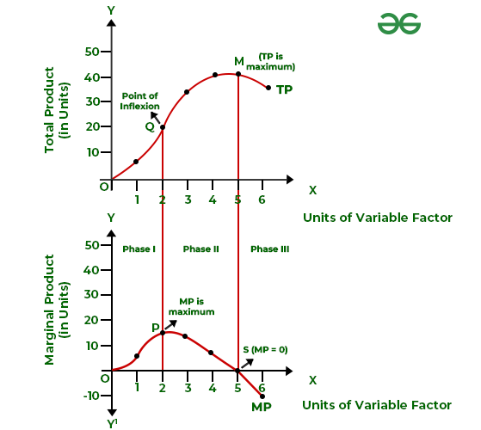

Slide 5
Three Stages of the Law
Stage I: Increasing Returns
  Total Product (TP) increases at an increasing rate.
  Marginal Product (MP) and Average Product (AP) both rise.
  Reason: better utilization of fixed factors.
Stage II: Diminishing Returns
  TP increases but at a diminishing rate.
  MP falls but remains positive.
  AP also starts declining after reaching its maximum.
  This is the rational stage of production.
Stage III: Negative Returns
  TP starts declining.
  MP becomes negative.
  AP continues to fall.
  Too much variable factor causes inefficiency.

