Slide 1

Python Programming
A Comprehensive Introduction to Python Basics
Presented by Aman Kumar
Asst. Professor, BCA/PGDCA, Khagarijan College

Slide 2


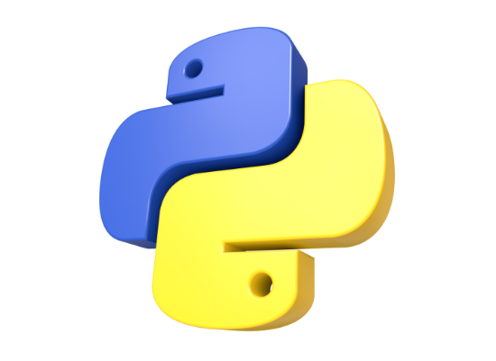
What is Python?
Created by Guido van Rossum and first released in 1991.
High-level, interpreted programming language with dynamic semantics.
Emphasizes code readability and simple, English-like syntax.
Supports multiple programming paradigms, including object-oriented and procedural.

Slide 3






Why Learn Python?
Easy to Learn
Highly Versatile
Strong Community
Features a simple, clean syntax that closely mimics natural English, making it highly readable for beginners.
Powers applications across web development, data science, artificial intelligence, and task automation.
Backed by a massive global developer community, providing robust libraries and extensive ongoing support.

Slide 4
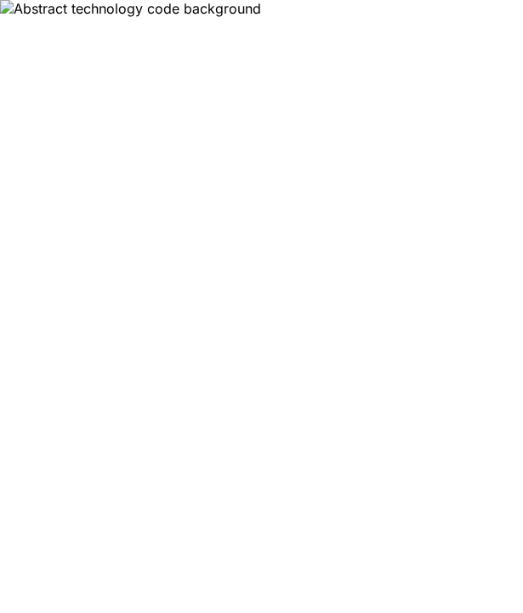
Core Capabilities
Python is dynamically typed, meaning you don't need to declare variable types upfront.
It is an interpreted language, executing code line by line for easier debugging and faster iterative development.
It is equipped with a massive standard library, offering "batteries included" functionality out of the box.

Slide 5
Core Concepts
Variables, Data Types, and Control Flow

Slide 6


Core Data Types
Variables
Data Types
Used to store data values in memory for processing.
Integers: Whole numbers (e.g., 10, -5)
Floats: Decimal numbers (e.g., 3.14, 0.5)
Dynamically typed; no explicit type declaration is needed.
Strings: Text enclosed in quotes (e.g., "Hello")
Variable names are case-sensitive and must start with a letter or underscore.
Booleans: True or False logic values

Slide 7



Control Flow
Conditionals
For Loops
While Loops
Use if, elif, and else statements to execute specific blocks of code based on dynamic conditions.
Iterate over sequences (like lists, strings, or ranges) to execute logic a predetermined number of times.
Continuously and repeatedly execute a block of code as long as a specified condition remains true.

Slide 8
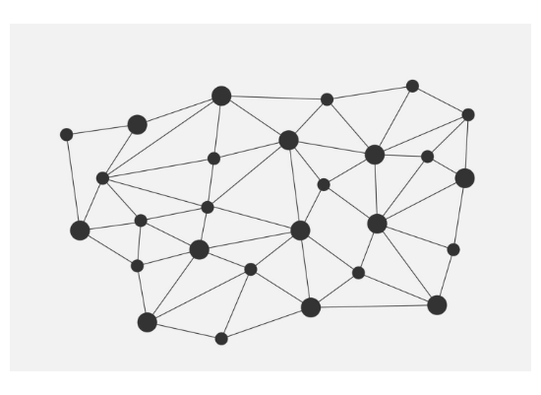
Lists & Dictionaries
Lists are ordered, mutable collections of items, created using square brackets [ ].
Dictionaries are unordered collections mapping unique keys to values, created using curly braces { }.
Both are core built-in structures, highly optimized for managing and retrieving complex datasets efficiently.

Slide 9
Reusable Functions
Functions are defined using the def keyword, allowing you to elegantly encapsulate reusable logic.
They accept arguments as input parameters and use the return keyword to pass computed values back.
Utilizing functions promotes strict modularity, significantly improving code maintainability across larger programs.

Slide 10
Thank You

