Slide 1

Data Structure Using
C Programming
Presented by
Aman Kumar
Assistant Professor, BCA/PGDCA
Khagarijan College, Nagaon

Slide 2
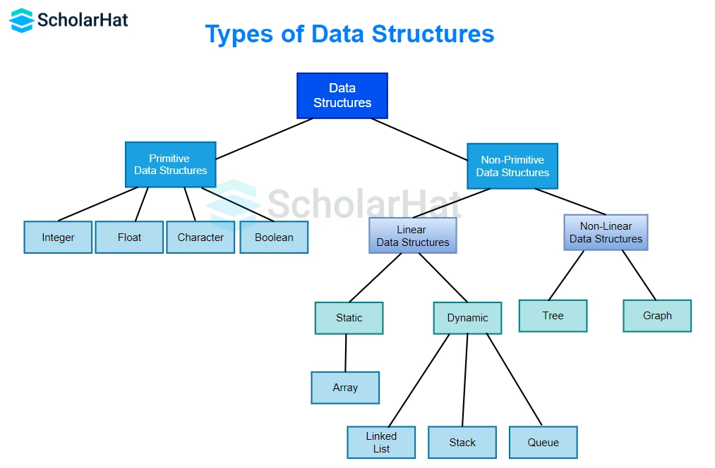
Introduction to Data Structures
Data Structure is a way of organizing and storing data efficiently.
Helps in performing operations like insertion, deletion, searching, sorting.
Implemented using programming languages like C.
Two main categories:
Linear Data Structures.
Non-linear Data Structures.

Slide 3
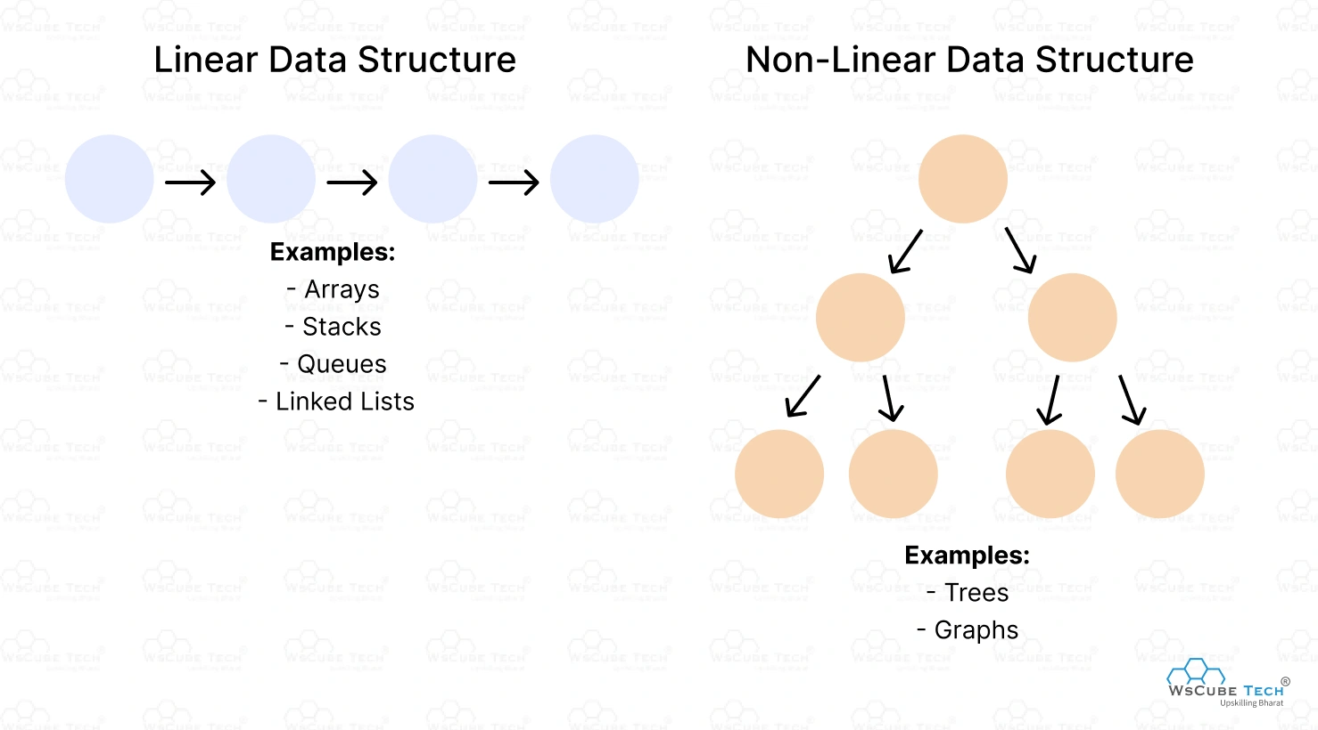
Types of Data Structures
Linear Data Structures:
Elements arranged sequentially.
Examples: Array, Linked List, Stack, Queue.
Non-Linear Data Structures:
Elements arranged hierarchically.
Examples: Trees, Graphs.
In C, dynamic structures like Linked Lists are created using pointers.

Slide 4
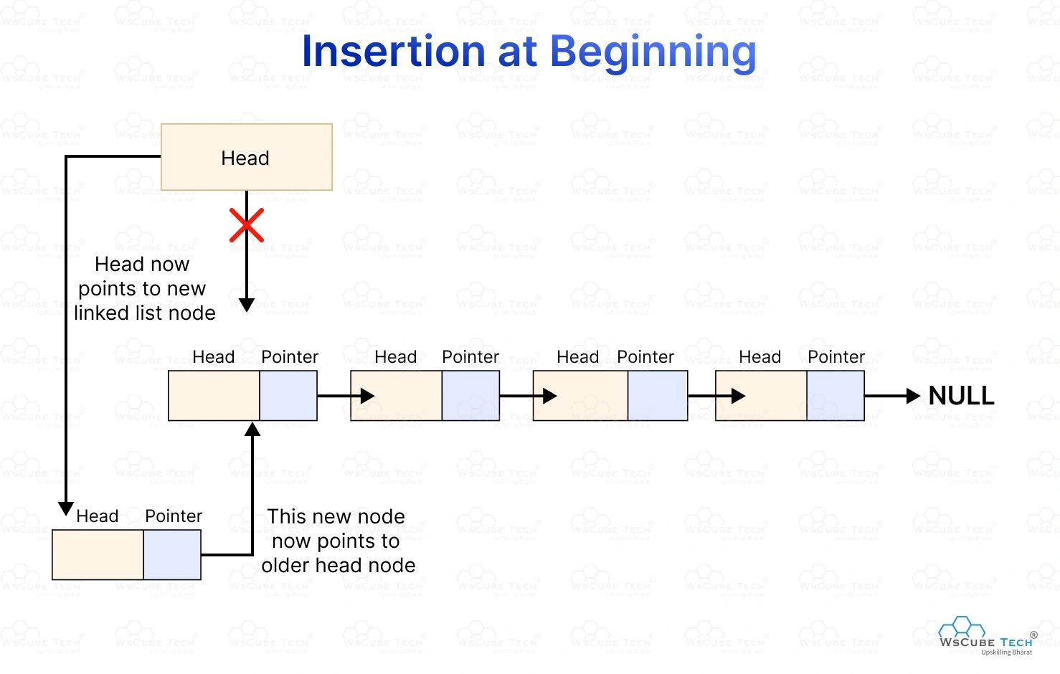
Linked List – Introduction
A collection of nodes connected using pointers.
Each node contains:
Data.
Address of next node.
Dynamic in size (unlike arrays).
Efficient memory utilization.

Slide 5
Types of Linked List
Singly Linked List: Each node contains data and a pointer to the next node only.
Doubly Linked List: Each node has pointers to both previous and next nodes.
Circular Linked List: The last node points back to the first node forming a loop.
Circular Doubly Linked List: Each node links both ways and the last node connects to the first.

Slide 6
Linked List – Advantages
Dynamic size (can grow/shrink).
No need for contiguous memory.
Better memory utilization.
Efficient insertion and deletion.

Slide 7
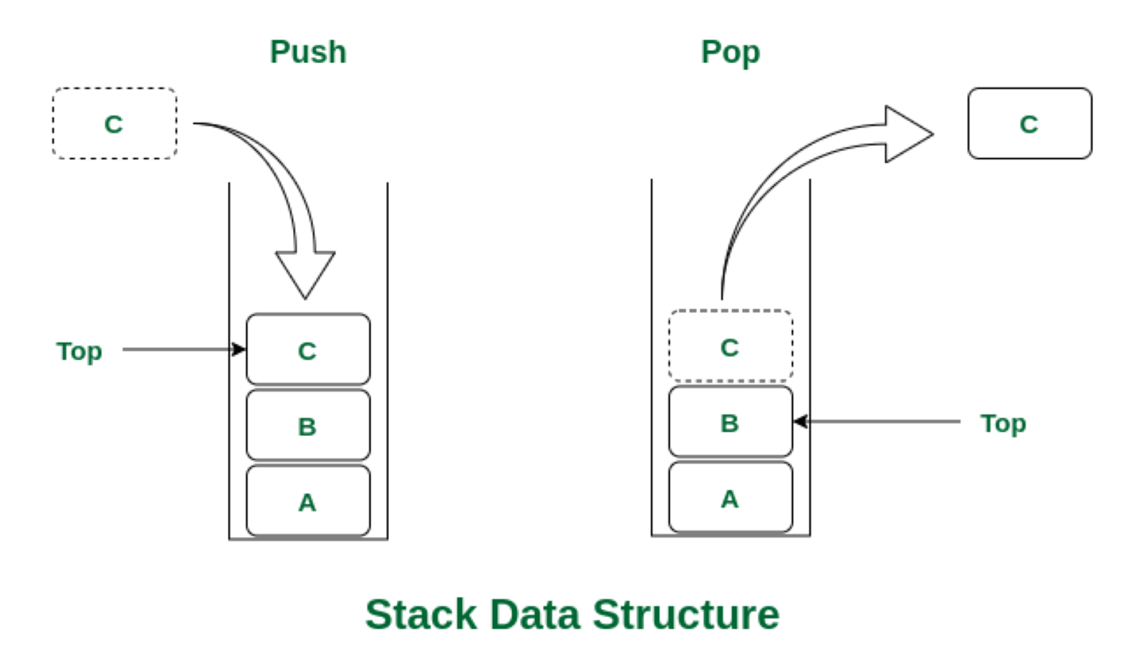
Stack – Introduction
Linear data structure following LIFO (Last In First Out).
Operations:
Push (insert)
Pop (remove)
Peek (top element)
Can be implemented using arrays or linked lists.

Slide 8
Stack – Advantages
Simple implementation
Efficient for recursive operations
Used in expression evaluation
Helps in backtracking (undo operations)

Slide 9
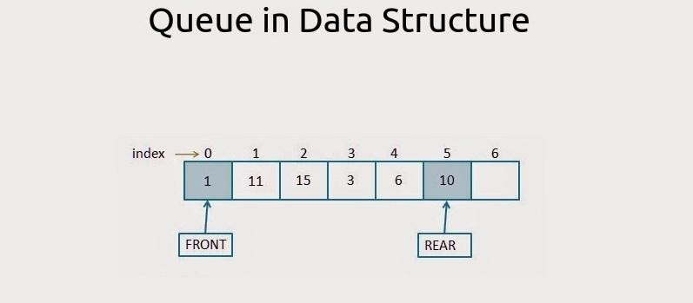
Queue – Introduction
Linear data structure following FIFO (First In First Out).
Operations:
Enqueue (insert).
Dequeue (remove).
Elements added at rear and removed from front.

Slide 10
Types of Queue
Simple Queue: Follows FIFO where elements are inserted at rear and removed from front.
Circular Queue: A queue where the last position connects back to the first to reuse space.
Priority Queue: Elements are served based on priority rather than order of insertion.
Double-ended Queue (Deque): Elements can be inserted and removed from both ends.

Slide 11
Queue – Advantages
Efficient in scheduling tasks.
Used in buffering and data handling.
Easy to implement.
Maintains order of processing.

Slide 12
Applications
Linked List → Dynamic memory management.
Stack → Function calls, recursion, undo operations.
Queue → CPU scheduling, printers, networking , widely used in system design and real-world applications.

Slide 13
Conclusion
Data structures improve efficiency of programs.
Linked List, Stack, Queue are fundamental concepts in C.
Choosing the right structure optimizes performance.
Essential for problem solving, algorithms, and software development.

Slide 14
Thank You

